Slide 1
Support Vector Machine

Slide 2
Today’s Lectures…
Support Vector Machine – intuition
Support Vector Machine – Mathematical understanding
Gradient Decent for Support Vector Machine
Implementation of Support Vector Machine

Slide 3
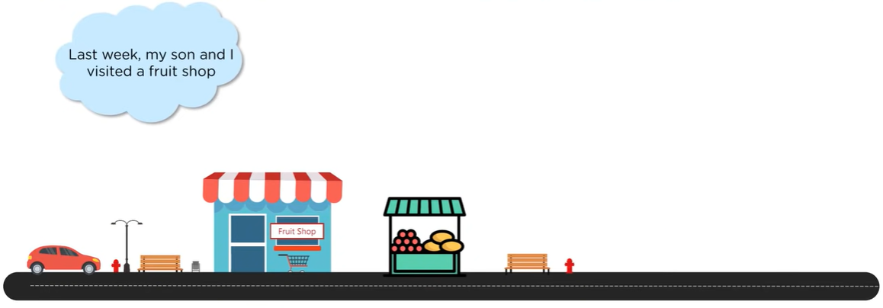
Why Support Vector Machine ….

Slide 4
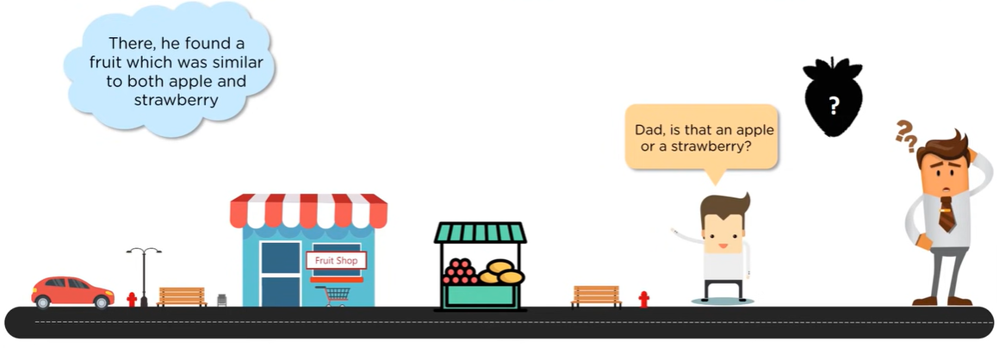
Why Support Vector Machine ….

Slide 5
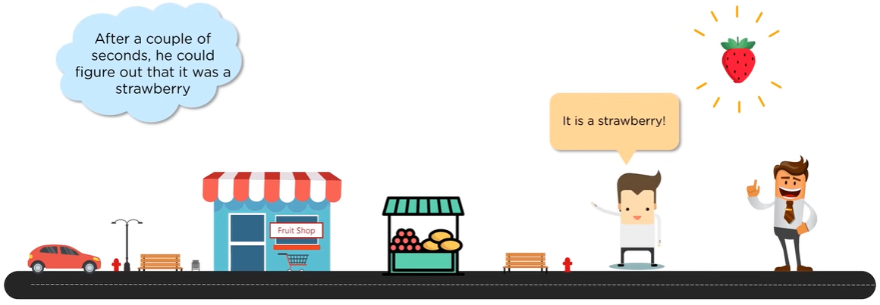
Why Support Vector Machine ….

Slide 6
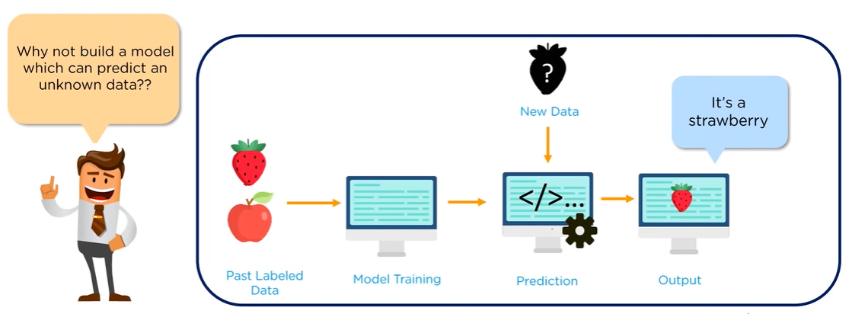
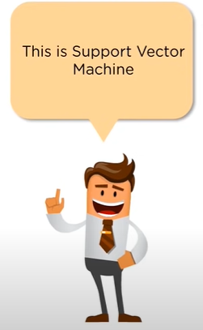
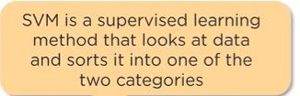
Why Support Vector Machine ….

Slide 7
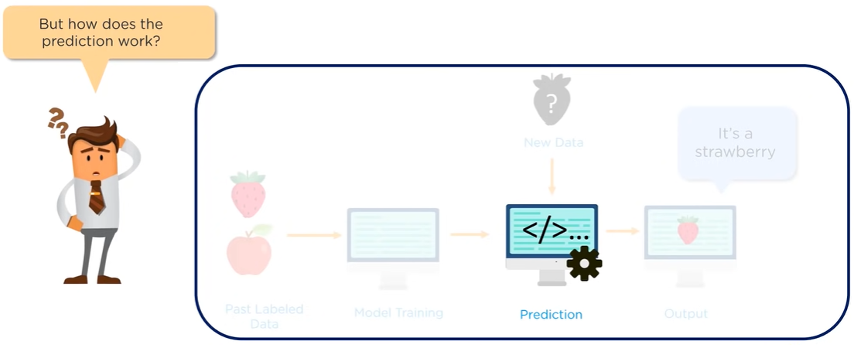
Why Support Vector Machine ….

Slide 8
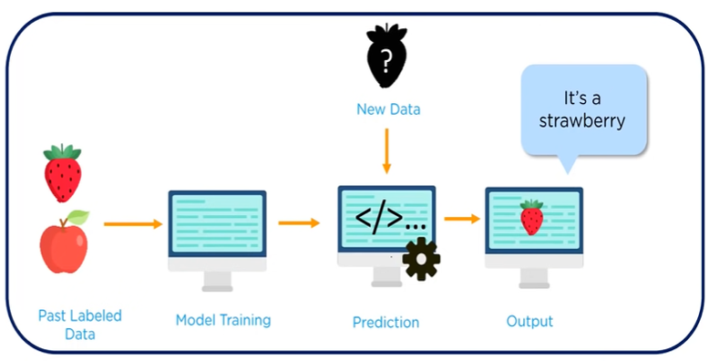
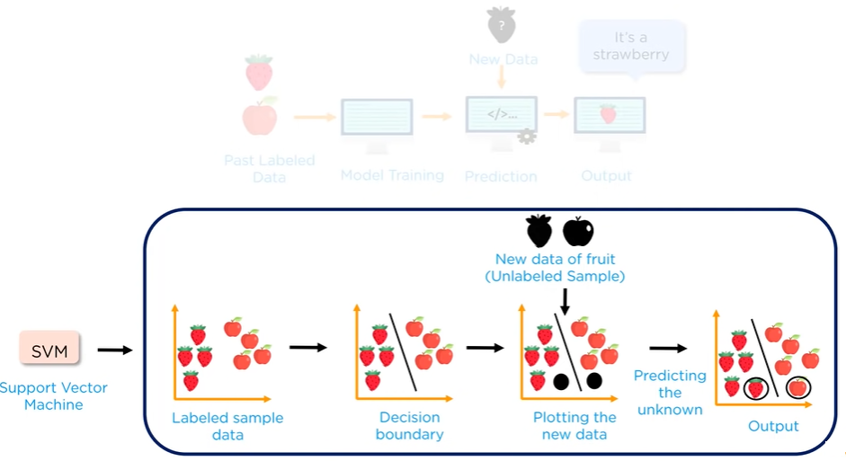
What is Support Vector Machine ….

Slide 9
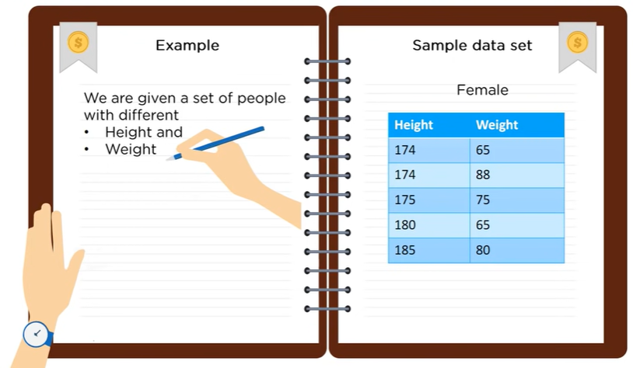
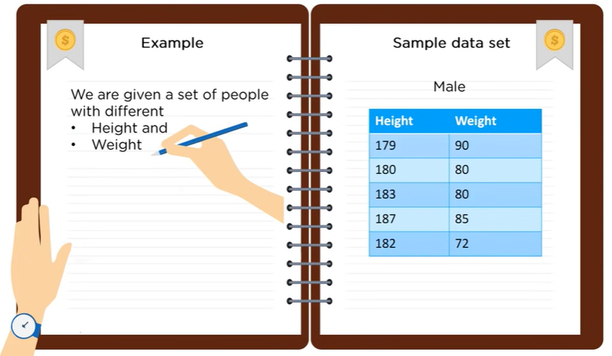
What is Support Vector Machine ….

Slide 10
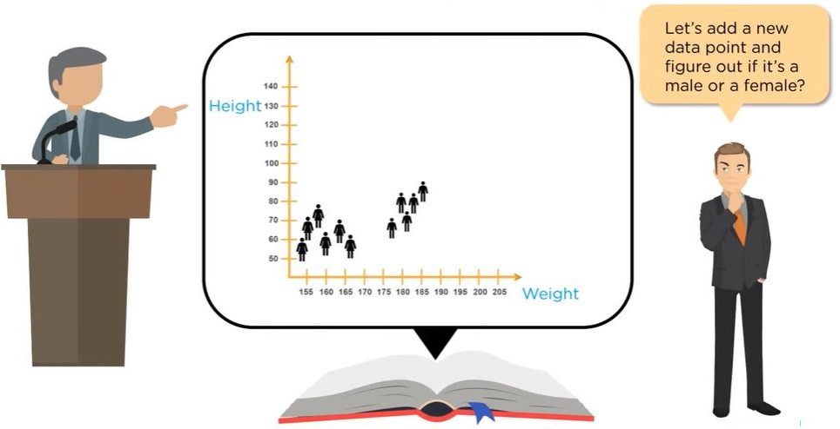
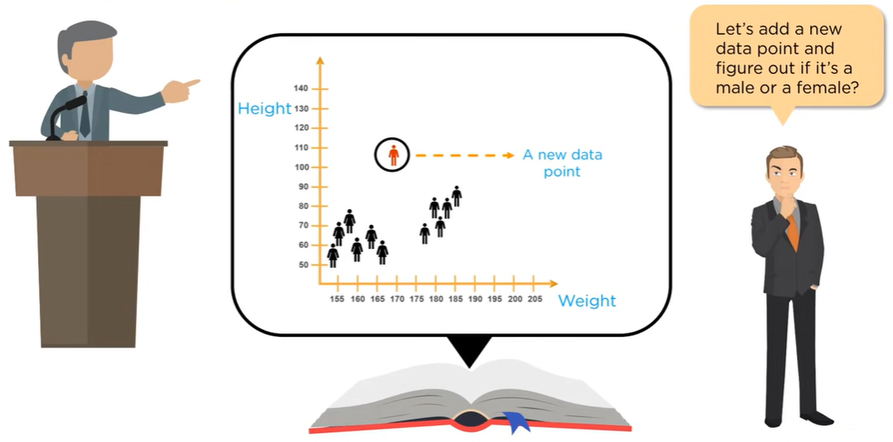
What is Support Vector Machine ….

Slide 11
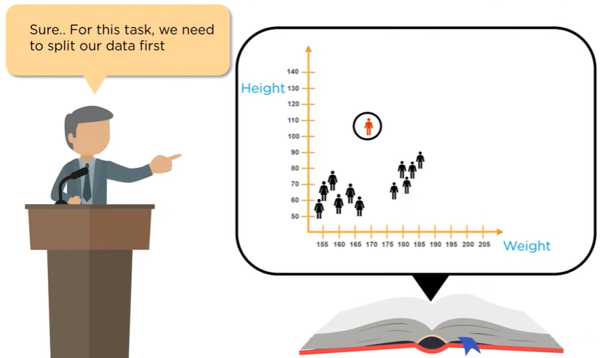
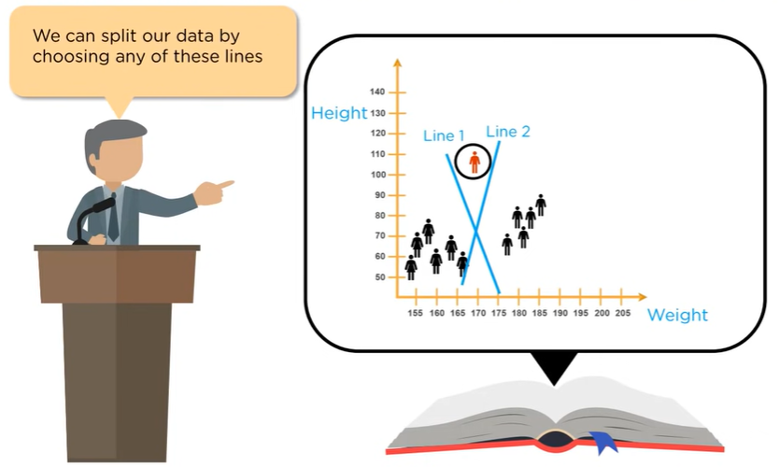
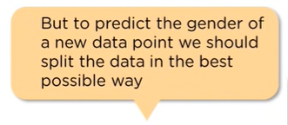
What is Support Vector Machine ….

Slide 12
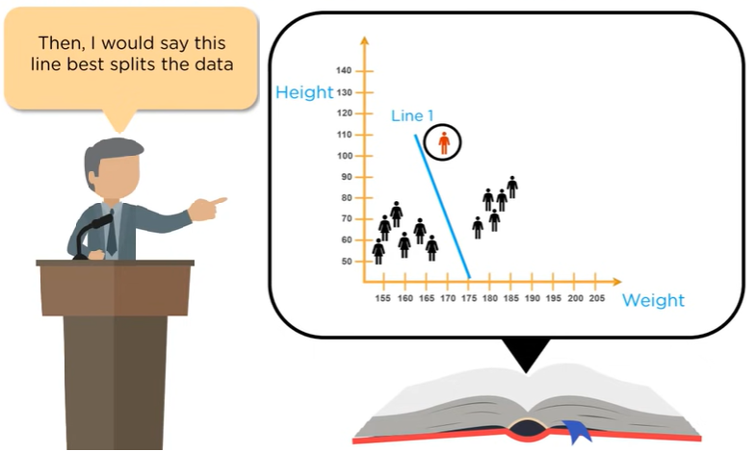
What is Support Vector Machine ….

Slide 13
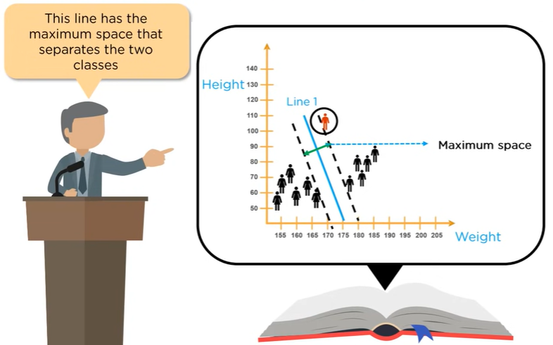
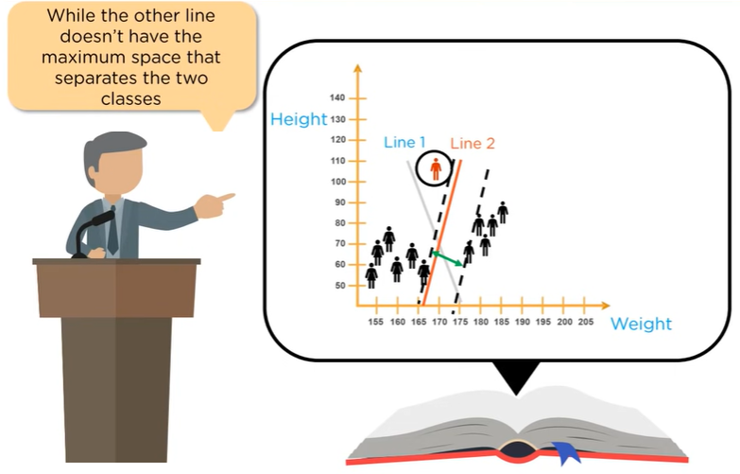
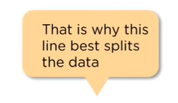
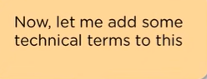
What is Support Vector Machine ….
We need to add some technical terms to it to know the exact process

Slide 14
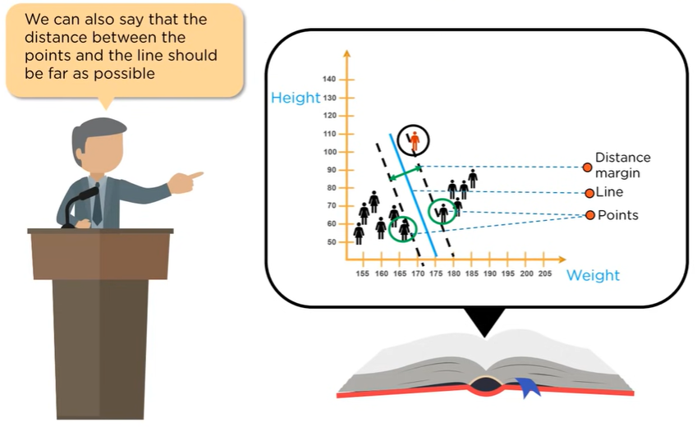
What is Support Vector Machine ….

Slide 15
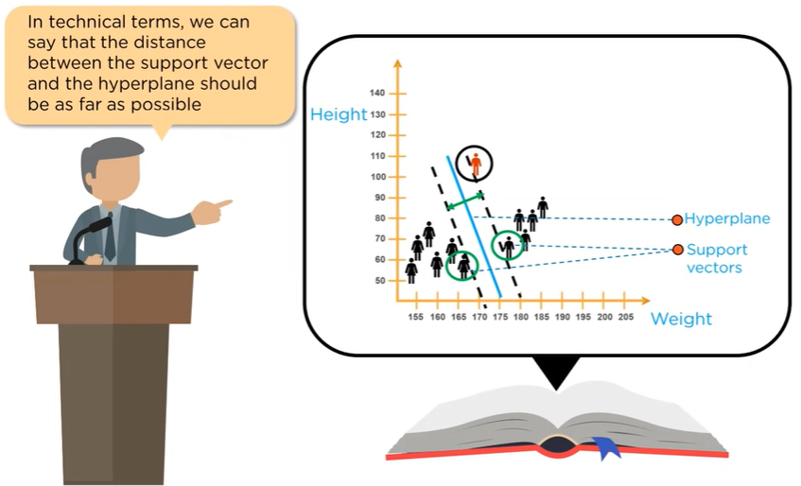
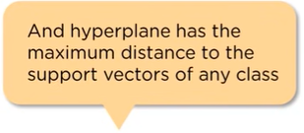
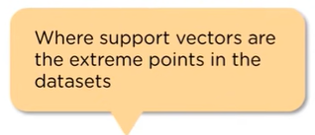
What is Support Vector Machine ….

Slide 16
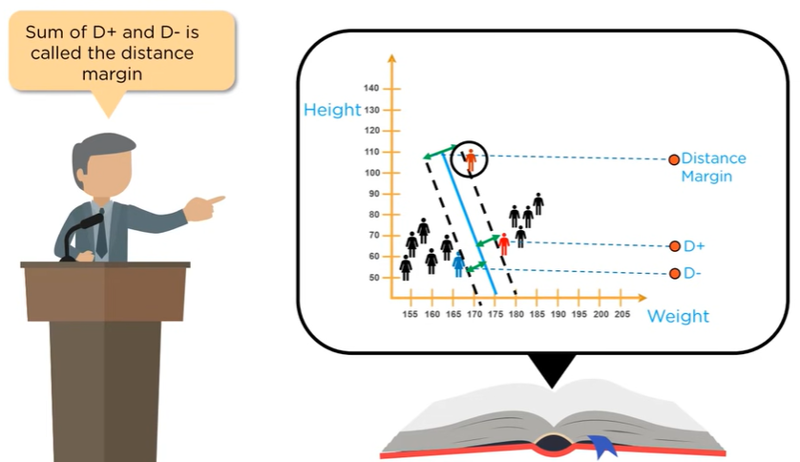
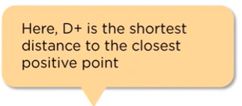
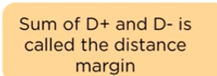
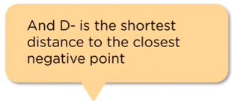
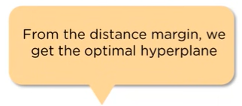
What is Support Vector Machine ….

Slide 17
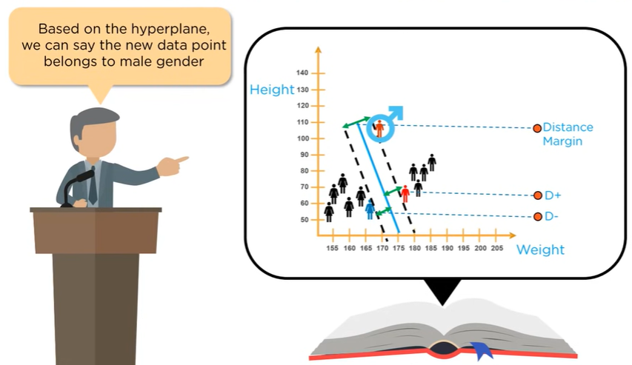

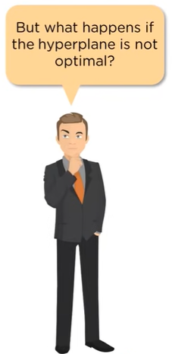
What is Support Vector Machine ….

Slide 18
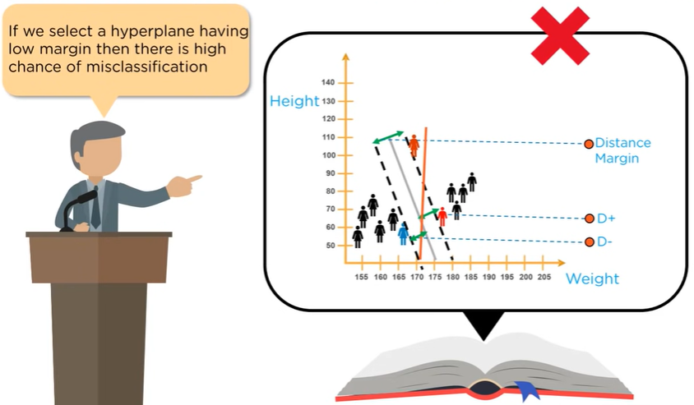
What is Support Vector Machine ….

Slide 19

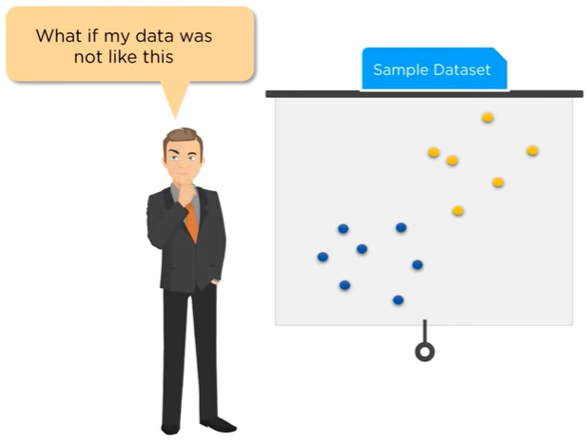
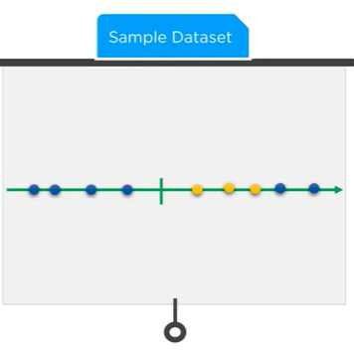

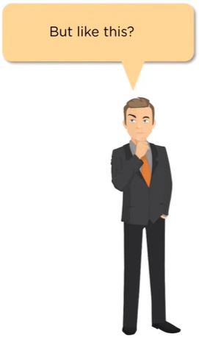
Understanding Support Vector Machine ….

Slide 20
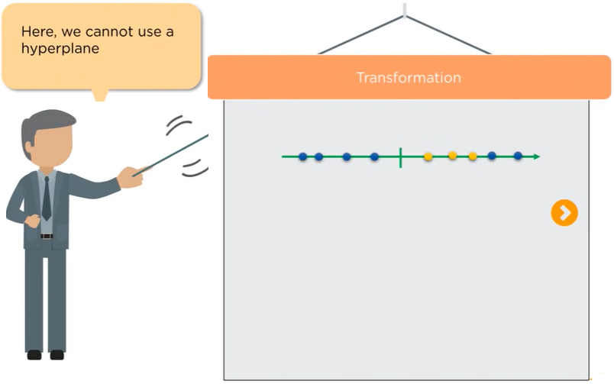
Understanding Support Vector Machine ….

Slide 21
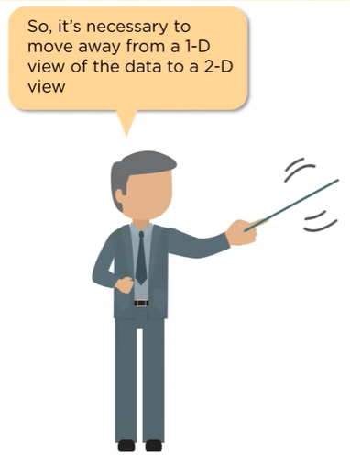
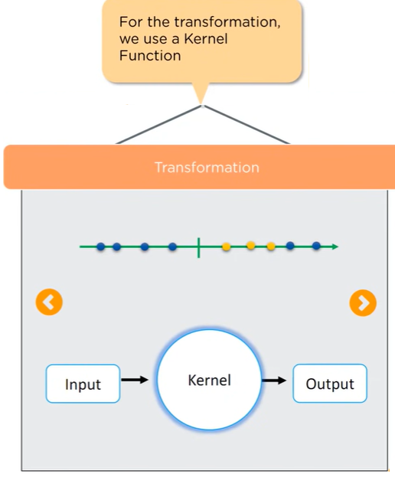
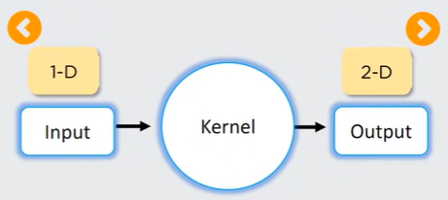
Understanding Support Vector Machine ….

Slide 22
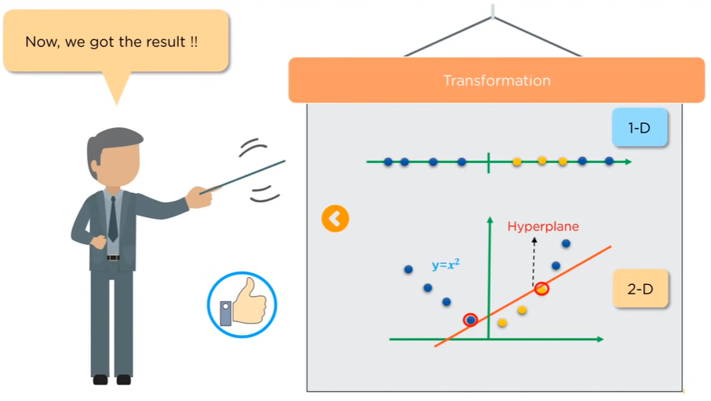
Understanding Support Vector Machine ….

Slide 23
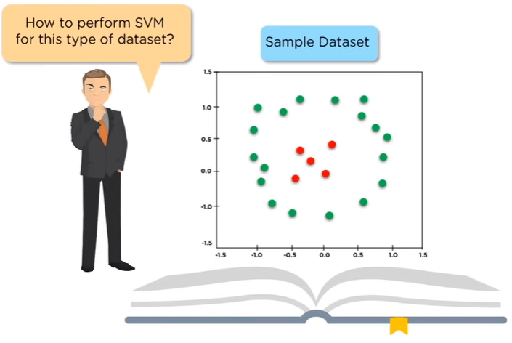
Understanding Support Vector Machine ….

Slide 24
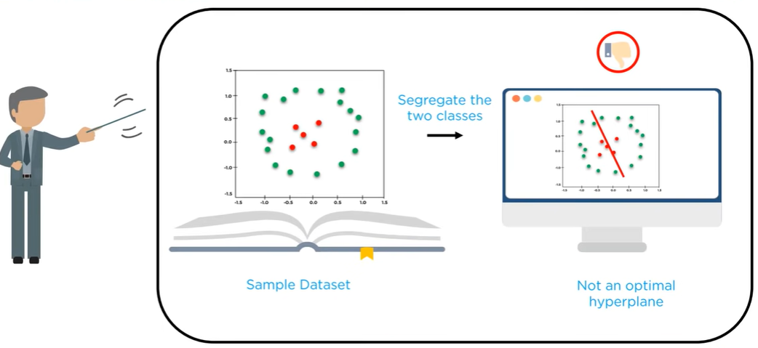
Understanding Support Vector Machine ….

Slide 25
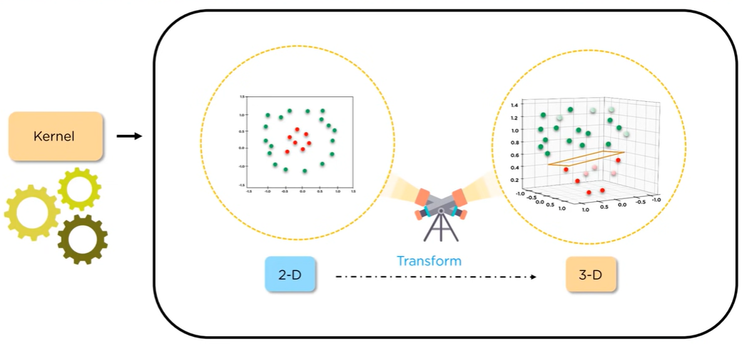
Understanding Support Vector Machine ….

Slide 26
Support Vector Machine - Intuition….
Support Vector Machine is a machine learning method to predict a binary outcome, such as yes or no, based on prior observations of a data set.

Slide 27
Support Vector Machine - Intuition….
There are two types of Classification
Binary Classification
Multiclass Classification

Slide 28
Support Vector Machine - Intuition….
Binary Classification Example
Will the customer Buy Life insurance or not?
Is the Cancer malignant or Benign?
Email: Spam or not?
Online Transaction: Fraudulent or not?
Tumor: Malignant or Benign?
A political candidate will win or lose an election?
A high school student will be admitted to a particular University or not?
These binary outcomes allow straightforward decisions between two alternatives.
Y ∈ {0,1}
0: “negative Class” (e.g Benign Tumor) sometime denoted by “–”
1: “Positive Class” (e.g Malignant Tumor) sometime denoted by “+”

Slide 29
Support Vector Machine - Intuition….
Multiclass Classification Example
The person will vote for PTI PML(N) PPPP Jamaat-e-Islami

Slide 30
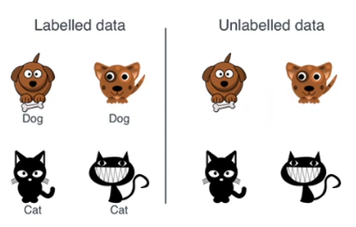
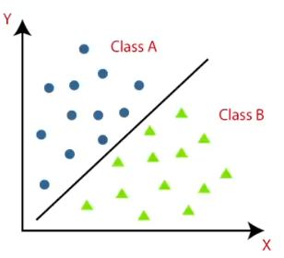
Support Vector Machine - Intuition….
Supervised Learning model
Its used for both Classification and regression model
It uses Hyperplane concept.
Support Vectors.

Slide 31
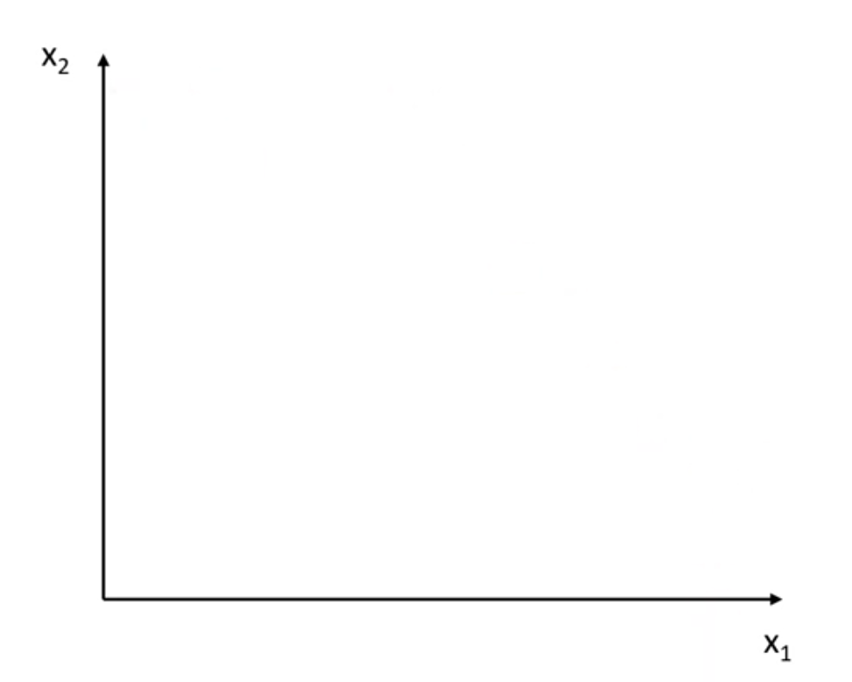
Support Vector Machine - Intuition….
We are trying to predict whether
the person has diabetes or not?
We have 2 features such as BMI as x₁ and Blood Sugar Level as x₂

Slide 32
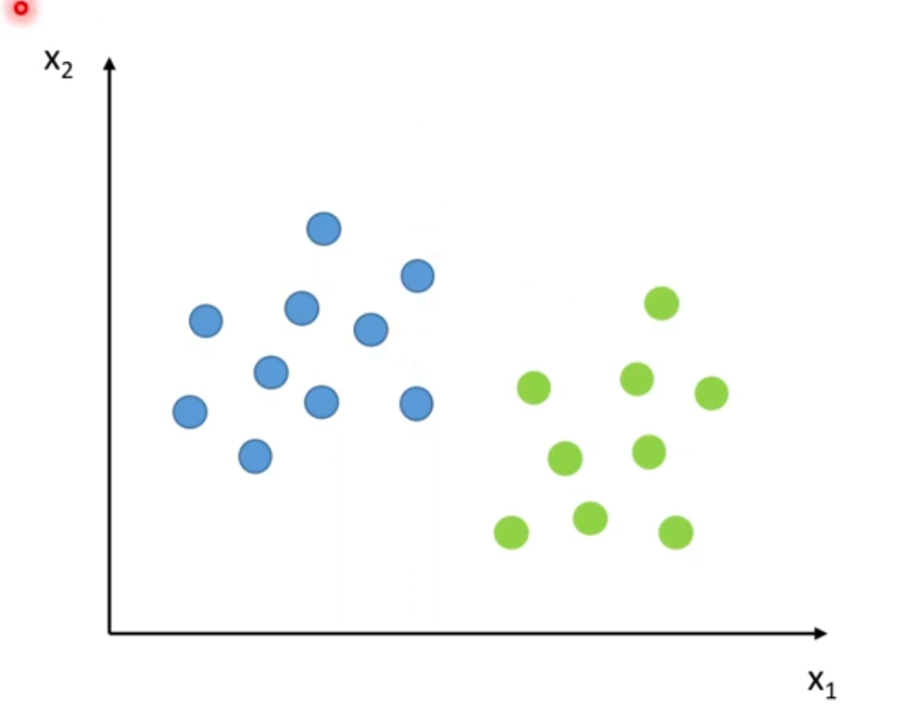
Support Vector Machine - Intuition….
We are trying to predict whether
the person has diabetes or not?
When we draw the data points on the graph, we can see that there is clear difference between 2 classes.

Slide 33
Support Vector Machine - Intuition….
We are trying to predict whether the person has diabetes or not?
SVM classifier would try to find a line that can separate these two data points

Slide 34
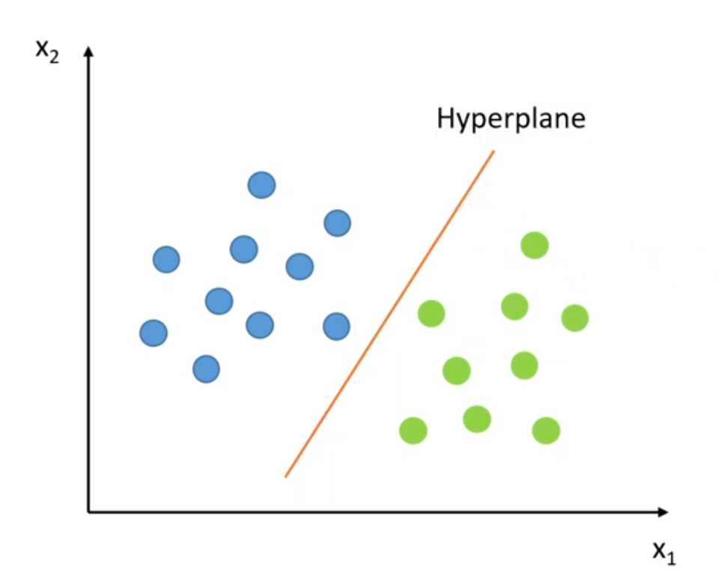
Support Vector Machine - Intuition….
We are trying to predict whether the person has diabetes or not?
SVM classifier would try to find a line that can separate these two data points.

Slide 35
Support Vector Machine - Intuition….
We are trying to predict whether the person has diabetes or not?
SVM classifier would predict whether a new data point would lie in which class.

Slide 36
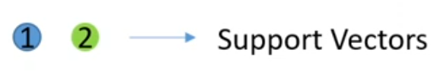

Support Vector Machine - Intuition….
We are trying to predict whether the person has diabetes or not?
In this example, we have two classes and we have two points 1 and 2 that are closet to the Hyperplane.
These are called Support Vectors.
Position of Hyperplane changes with the position of Support vectors

Slide 37
Support Vector Machine - Intuition….
We are trying to predict whether
the person has diabetes or not?
SVM classifier would try to find the hyperplanes (that separate data point into two classes) and Support Vectors.

Slide 38

Support Vector Machine - Intuition….
We are trying to predict whether
the person has diabetes or not?
What if data points is not linearly separable ?
Look in Fig. how can we separate the data-points linearly?

Slide 39
Support Vector Machine - Intuition….
We are trying to predict whether
the person has diabetes or not?
We would not be able to find the line that separates separate data point into two classes and Support Vectors.

Slide 40
Support Vector Machine - Intuition….
We are trying to predict whether
the person has diabetes or not?
This type of situation comes very often in machine learning world as raw data are always non-linear here. So, Is it do-able?

Slide 41
Support Vector Machine - Intuition….
We are trying to predict whether
the person has diabetes or not?
Yes!!. we will add one extra dimension to the data points to make it separable.

Slide 42

Support Vector Machine - Intuition….
We are trying to predict whether
the person has diabetes or not?
We can increase the number of dimensions so now SVM classifier would be able to find the plane that separates separate data point into two classes and Support Vectors.

Slide 43

Support Vector Machine - Intuition….
We are trying to predict whether
the person has diabetes or not?
The process of making non-linearly separable data point to linearly separable data point is also known as Kernel Trick.

Slide 44

Support Vector Machine - Intuition….

Slide 45

Support Vector Machine - Intuition….
We are trying to predict whether
the person has diabetes or not?
If you look in Figure there are numbers of hyperplane that can separate the data points in two components. So optimal hyperplane is one which divides the data points very well.
So question is why it is needed to choose optimal hyper plane?

Slide 46
Support Vector Machine - Intuition….
We are trying to predict whether
the person has diabetes or not?
So if you choose sub-optimal hyperplane, no doubt after number of training iteration , training error will decrease but during testing when an unseen instance will come, it will result in high test error.
In that case it is must to choose an optimal plane to get good accuracy.

Slide 47

Support Vector Machine - Intuition….

Slide 48

Support Vector Machine - Intuition….

Slide 49

Support Vector Machine - Intuition….
Hyperplane is a line (in 2D space and plane on 3D space and hyperplane in more then 3D space) that separate data points into two classes.
Support Vectors are the data points that lie nearest to the hyperplane. If the these data points changes then the position of Hyperplane also changes.
Support Vectors should be as far as possible to the hyperplane other it would be very difficult to classify the data points.

Slide 50
Support Vector Machine - Intuition….
Solid black line is optimal hyperplane.
Two dotted line is some hyperplane, which is passing through nearest data points to the optimal hyperplane.
Then distance between hyperplane and optimal hyperplane is know as margin, and Margin is an area which do not contains any data points.
There will be some cases when we have data points in margin area but right now we stick to margin as no data points lands.

Slide 51
Support Vector Machine - Intuition….
So, when we are choosing optimal hyperplane we will choose one among set of hyperplane which is highest distance from the closest data points.
If optimal hyperplane is very close to data points then margin will be very small and it will generalize well for training data but when an unseen data will come it will fail to generalize well.
So our goal is to maximize the margin so that our classifier is able to generalize well for unseen instances.

Slide 52
Support Vector Machine - Intuition….
The main objective of SVM is to find the optimal hyperplane which linearly separates the data points in two component by maximizing the margin.

Slide 53
Support Vector Machine - Intuition….
Advantages
Works well with smaller datasets.
Works efficiently when there is a clear margin of separation.
Works well with high dimensional data, good to find complex relationship.
Disadvantages
Not suitable for large datasets as training time is higher.
Not suitable for noisier datasets with overlapping classes.
Choose SVM if
Features are more and dataset is small as it is good to find complex relationship b/w data.
Choose logistic regression if
Features are less and dataset is large.

Slide 54
Math's Behind…
Let’s look at the two-dimensional case first. The two-dimensional linearly separable data can be separated by a line. The function of the line is y=ax+b
We rename x with x1 and y with x2 and we get:
ax1−x2+b=0
If we define x = (x1,x2) and w = (a,−1), we get:
w⋅x+b=0

Slide 55





Slide 56
Chapter Reading
Feedback
Questions or Comments?

